Slide 1

Notes:
Source: Oxford International Primary Computing Student Book 4, Unit 2 Using the world wide web, section 2.3 Improving your web search, printed pages 26–27, and section 2.4 Browsing and using bookmarks, pages 28–29. Classroom adaptation. Generated illustrations are teaching examples. Search symbol support may vary by search engine.

Slide 2
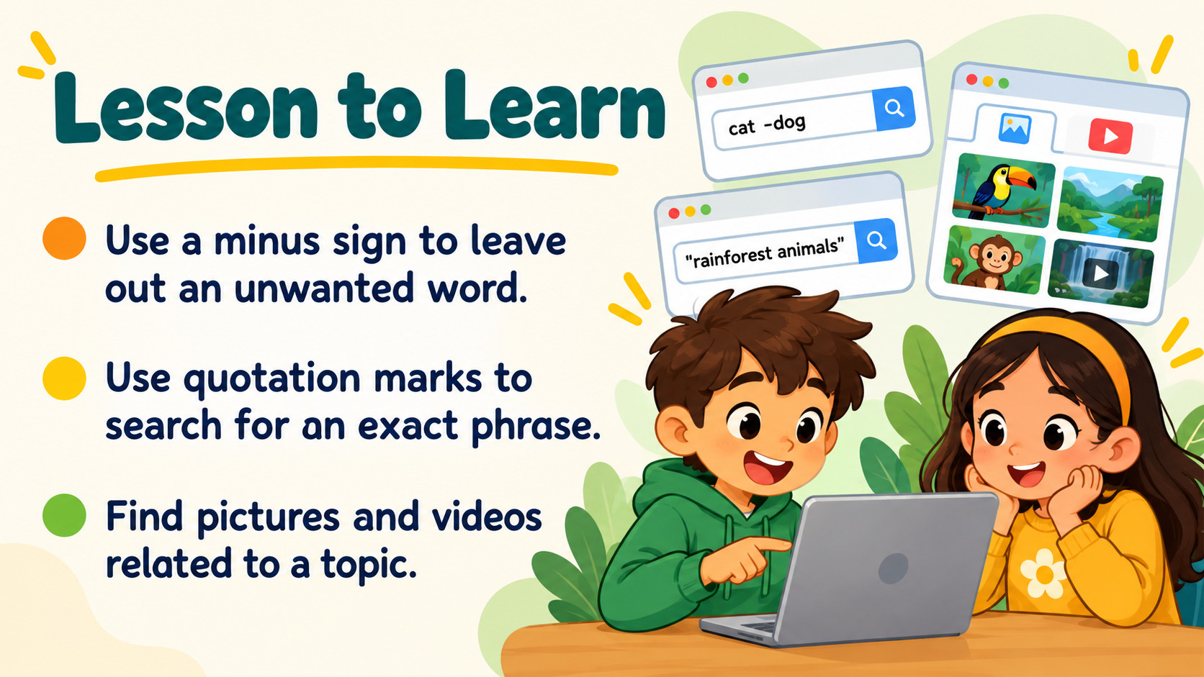
Notes:
Source: Oxford International Primary Computing Student Book 4, Unit 2 Using the world wide web, section 2.3 Improving your web search, printed pages 26–27, and section 2.4 Browsing and using bookmarks, pages 28–29. Classroom adaptation. Generated illustrations are teaching examples. Search symbol support may vary by search engine.

Slide 3

Notes:
Source: Oxford International Primary Computing Student Book 4, Unit 2 Using the world wide web, section 2.3 Improving your web search, printed pages 26–27, and section 2.4 Browsing and using bookmarks, pages 28–29. Classroom adaptation. Generated illustrations are teaching examples. Search symbol support may vary by search engine.

Slide 4

Notes:
Source: Oxford International Primary Computing Student Book 4, Unit 2 Using the world wide web, section 2.3 Improving your web search, printed pages 26–27, and section 2.4 Browsing and using bookmarks, pages 28–29. Classroom adaptation. Generated illustrations are teaching examples. Search symbol support may vary by search engine.

Slide 5
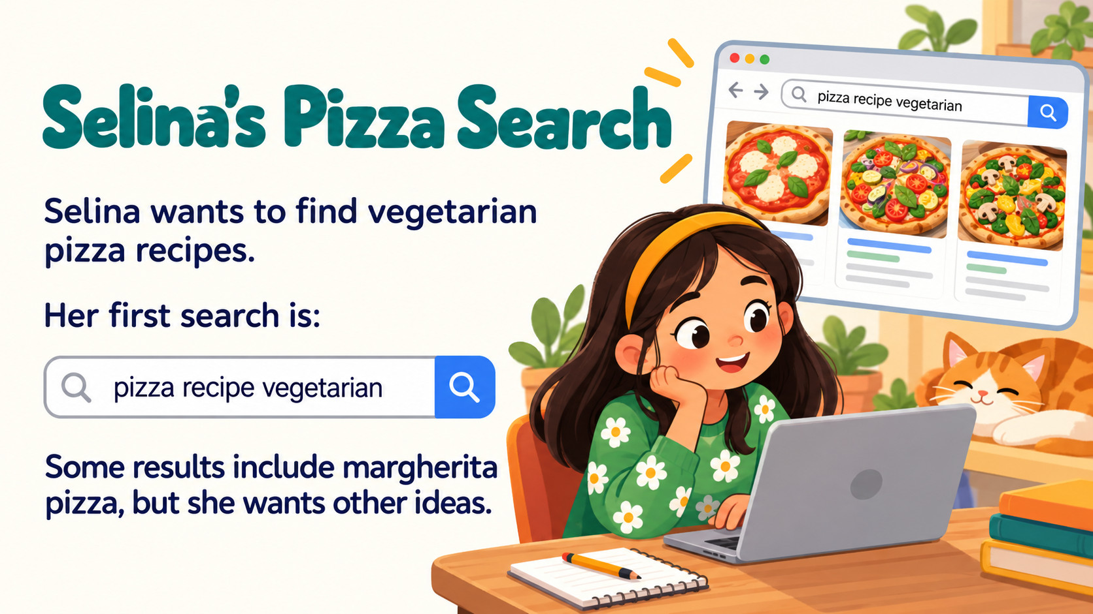
Notes:
Source: Oxford International Primary Computing Student Book 4, Unit 2 Using the world wide web, section 2.3 Improving your web search, printed pages 26–27, and section 2.4 Browsing and using bookmarks, pages 28–29. Classroom adaptation. Generated illustrations are teaching examples. Search symbol support may vary by search engine.

Slide 6
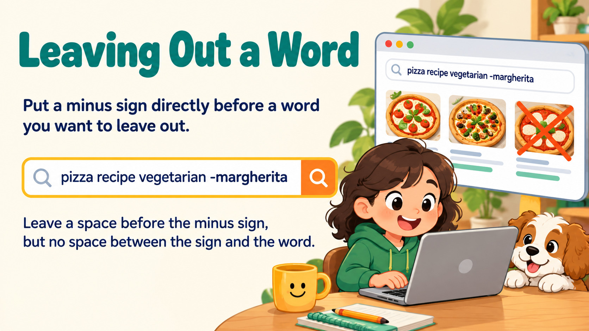
Notes:
Source: Oxford International Primary Computing Student Book 4, Unit 2 Using the world wide web, section 2.3 Improving your web search, printed pages 26–27, and section 2.4 Browsing and using bookmarks, pages 28–29. Classroom adaptation. Generated illustrations are teaching examples. Search symbol support may vary by search engine.

Slide 7
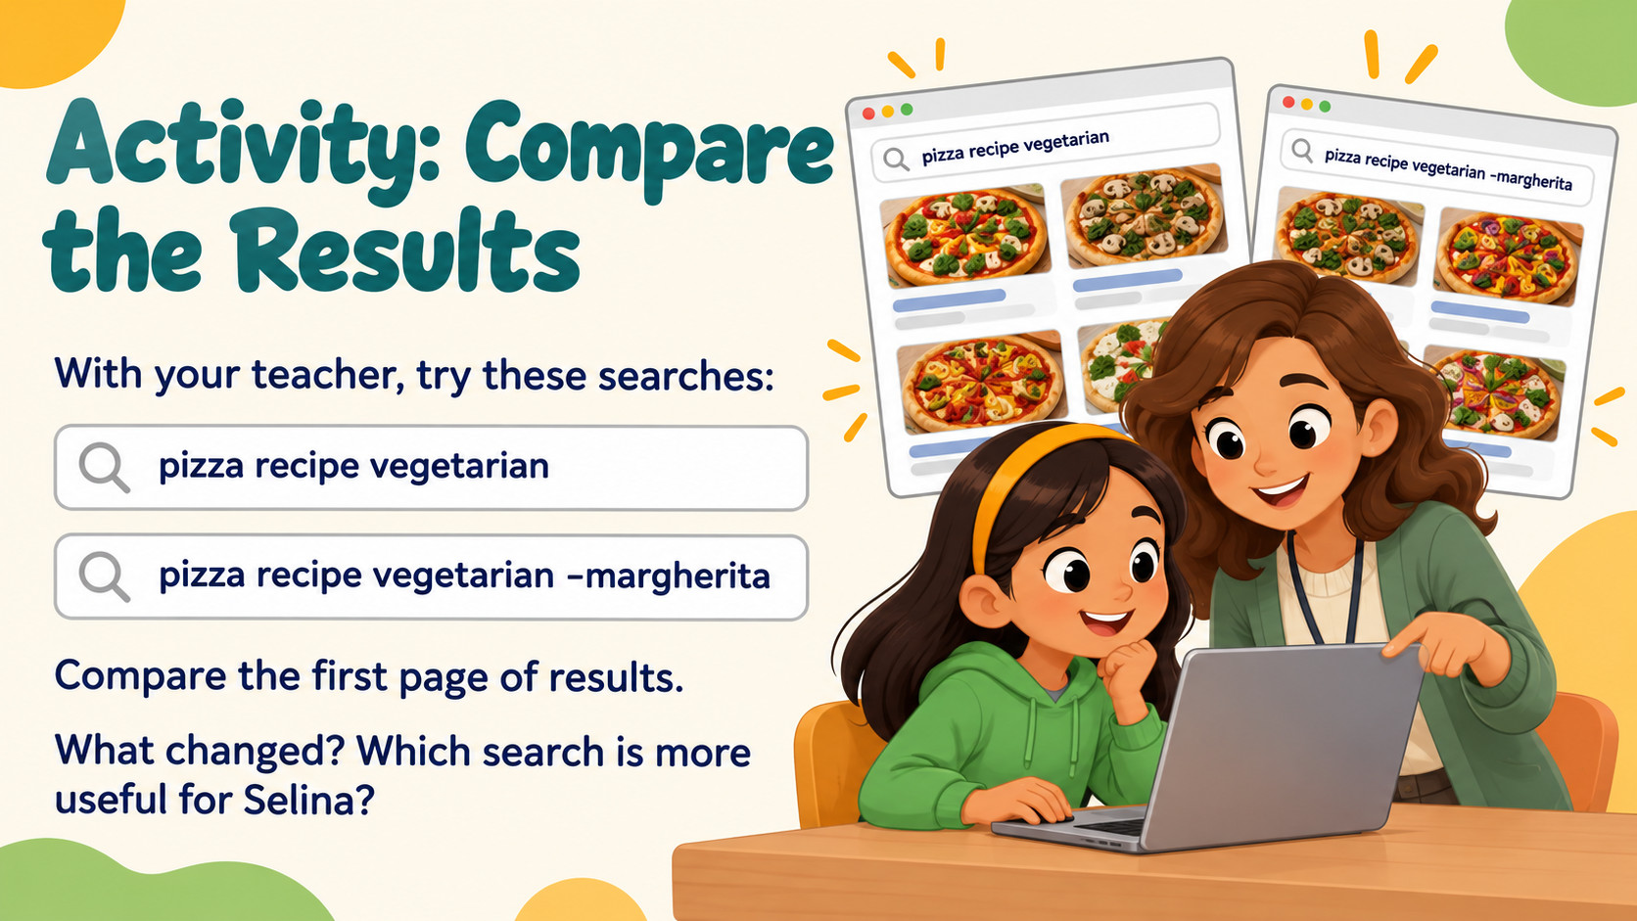
Notes:
Source: Oxford International Primary Computing Student Book 4, Unit 2 Using the world wide web, section 2.3 Improving your web search, printed pages 26–27, and section 2.4 Browsing and using bookmarks, pages 28–29. Classroom adaptation. Generated illustrations are teaching examples. Search symbol support may vary by search engine.

Slide 8

Notes:
Source: Oxford International Primary Computing Student Book 4, Unit 2 Using the world wide web, section 2.3 Improving your web search, printed pages 26–27, and section 2.4 Browsing and using bookmarks, pages 28–29. Classroom adaptation. Generated illustrations are teaching examples. Search symbol support may vary by search engine.

Slide 9
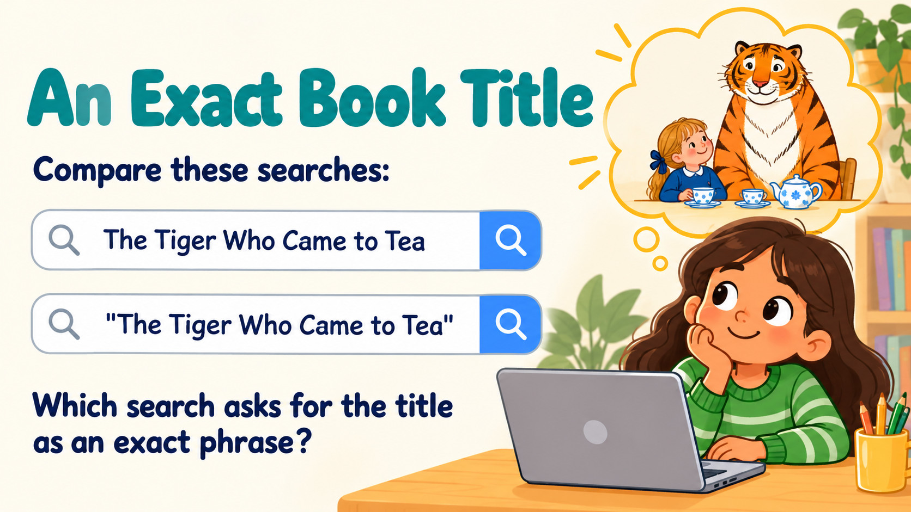
Notes:
Source: Oxford International Primary Computing Student Book 4, Unit 2 Using the world wide web, section 2.3 Improving your web search, printed pages 26–27, and section 2.4 Browsing and using bookmarks, pages 28–29. Classroom adaptation. Generated illustrations are teaching examples. Search symbol support may vary by search engine.

Slide 10
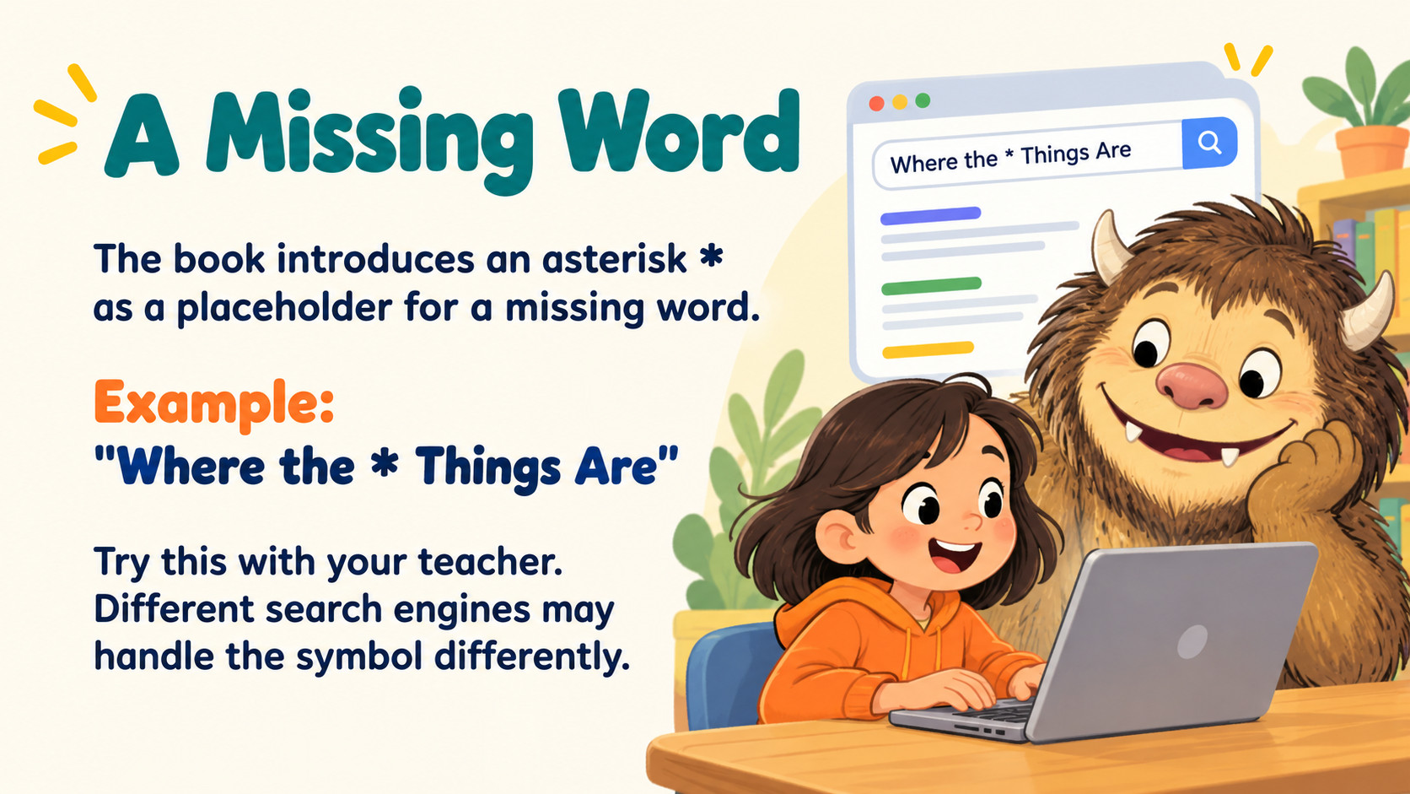
Notes:
Source: Oxford International Primary Computing Student Book 4, Unit 2 Using the world wide web, section 2.3 Improving your web search, printed pages 26–27, and section 2.4 Browsing and using bookmarks, pages 28–29. Classroom adaptation. Generated illustrations are teaching examples. Search symbol support may vary by search engine.

Slide 11

Notes:
Source: Oxford International Primary Computing Student Book 4, Unit 2 Using the world wide web, section 2.3 Improving your web search, printed pages 26–27, and section 2.4 Browsing and using bookmarks, pages 28–29. Classroom adaptation. Generated illustrations are teaching examples. Search symbol support may vary by search engine.

Slide 12

Notes:
Source: Oxford International Primary Computing Student Book 4, Unit 2 Using the world wide web, section 2.3 Improving your web search, printed pages 26–27, and section 2.4 Browsing and using bookmarks, pages 28–29. Classroom adaptation. Generated illustrations are teaching examples. Search symbol support may vary by search engine.

Slide 13

Notes:
Source: Oxford International Primary Computing Student Book 4, Unit 2 Using the world wide web, section 2.3 Improving your web search, printed pages 26–27, and section 2.4 Browsing and using bookmarks, pages 28–29. Classroom adaptation. Generated illustrations are teaching examples. Search symbol support may vary by search engine.

Slide 14

Notes:
Source: Oxford International Primary Computing Student Book 4, Unit 2 Using the world wide web, section 2.3 Improving your web search, printed pages 26–27, and section 2.4 Browsing and using bookmarks, pages 28–29. Classroom adaptation. Generated illustrations are teaching examples. Search symbol support may vary by search engine.

Slide 15
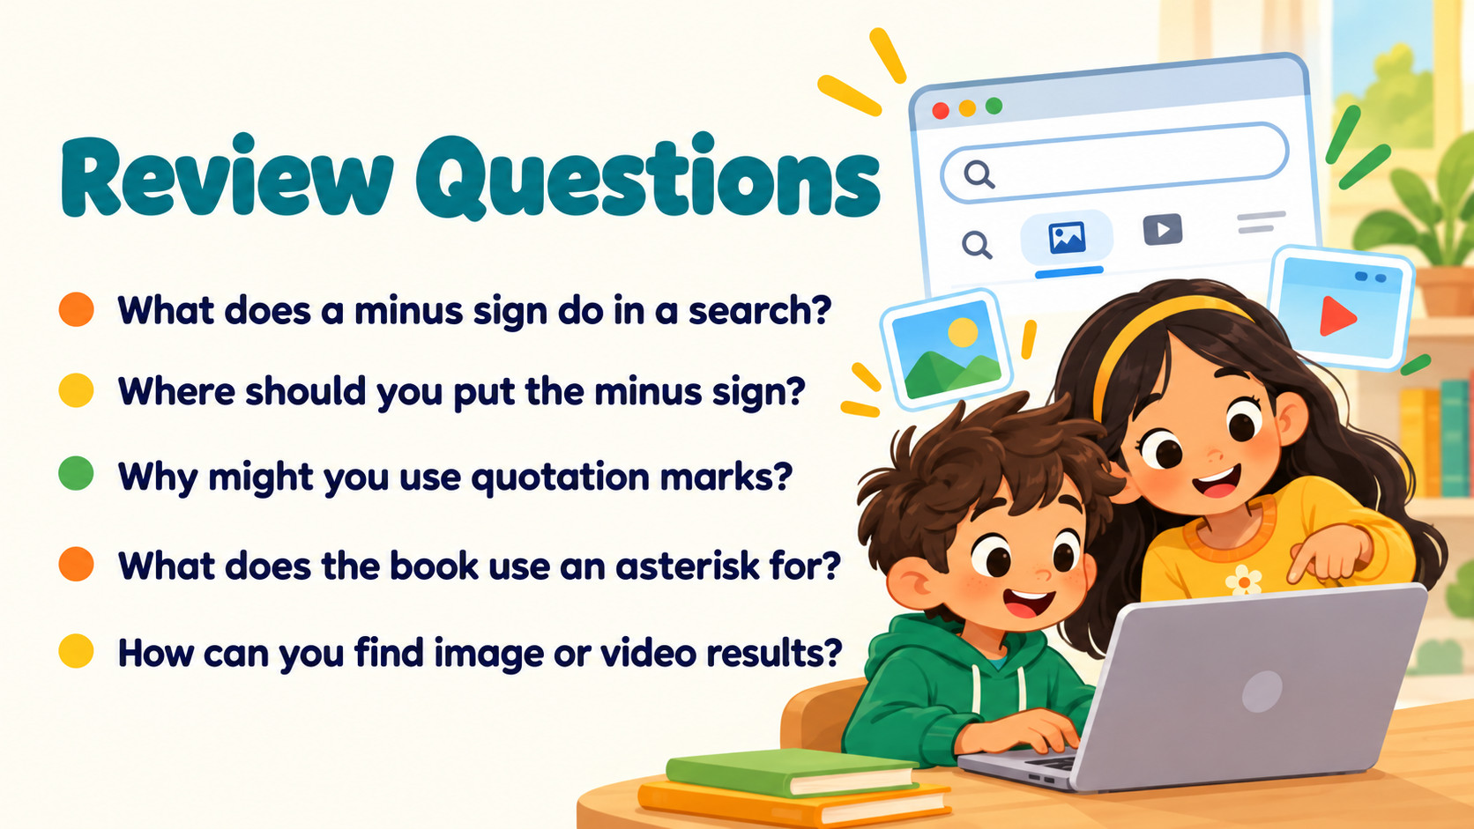
Notes:
Source: Oxford International Primary Computing Student Book 4, Unit 2 Using the world wide web, section 2.3 Improving your web search, printed pages 26–27, and section 2.4 Browsing and using bookmarks, pages 28–29. Classroom adaptation. Generated illustrations are teaching examples. Search symbol support may vary by search engine.

